Slide 1
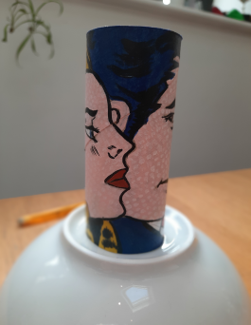
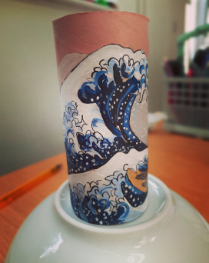
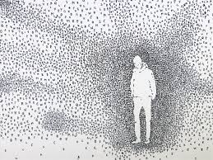
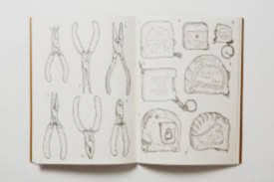
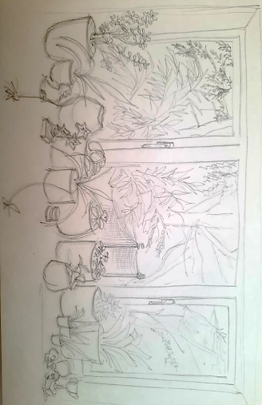
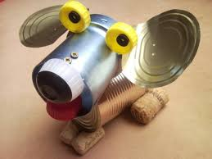
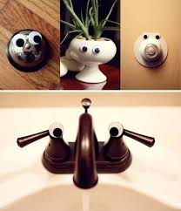
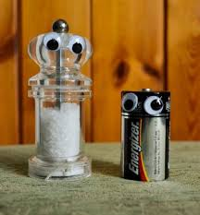
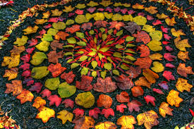
Complete as many of these tasks as you like.
TASK 3: Watch the following link:https://www.bbc.co.uk/programmes/articles/1qH7HdsPVm8vvRSjHv7Cw7C/meet-the-man-drawing-everything-in-his-grandfather-s-shed
create a piece in the style of the artist using pen line drawing only of objects from your bedroom. Try to fill the page in the same way as the artist.
TASK 5:
Choose a word from the following list and create a piece of art inspired by it. You choose the medium, size and style.
Home
Isolation
Lock
Happiness
Family
Friends
Contentment
TASK 1: Using a toilet roll tube, re- create a famous piece of art. You can use paint, pencil, pen, tissue paper, magazine(collage)
Art Challenge tasks
TASK 2: Draw the view of a window sill and view out of the window. Will you keep it black and white or add colour? Use a media of your choice.
TASK 4: Create a sculpture from found objects in your home or garden. You could use recycled
TASK 6
Make some googly eyes (or use some if you already have some) to create a series of photographs of googly creatures around your house. Try to take your photographs in an artistic fashion (consider the composition and focus)
TASK 4: Create a sculpture from found objects in your home or garden. You could use recycled materials or create some land art in the style of Richard Long or Andy Goldsworthy

Slide 2
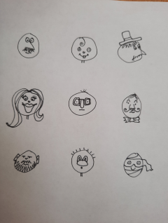
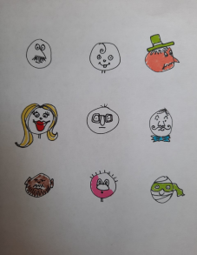
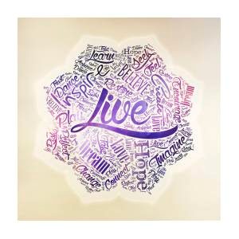
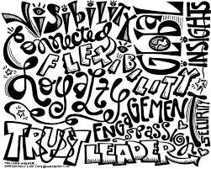
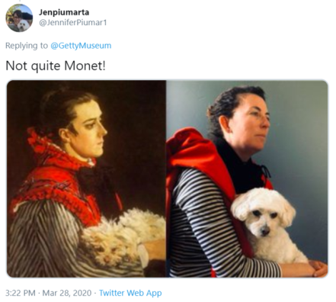
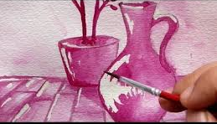
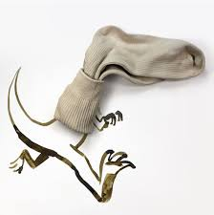
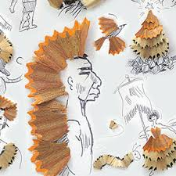
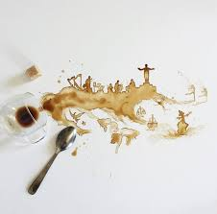
7.
Complete as many of these tasks as you like.
7.
Using the word ‘boredom’, create a word cloud associating other words with it in the colours and choice of font. You can do this on the computer or by hand.
TASK 11. Recreate a famous piece of art inspired by the Getty museums challenge:https://www.designboom.com/art/getty-museum-self-isolation-recreate-famous-artworks-03-30-2020/ Photograph your effort
TASK 9:
Take a circle- draw a series of 9 free hand circles on one page and turn them into creative cartoon characters
TASK 7:
Using the word ‘boredom’, create a word cloud associating other words with it in the colours and choice of font. You can do this on the computer or by hand.
hand.
Art Challenge tasks
TASK 10.
Looking online for inspiration, create a piece of art with a natural material as your paint. Look up painting with coffee and beetroot.
7
TASK 12:
Choose a ‘How to draw’ challenge from Youtube and show what you can master! You choose the level you think you are at. How about challenging yourself to something you think you could never do?!
https://www.youtube.com/results?search_query=how+to+draw
TASK 8:
Take a photo of an everyday object in your home (or from the internet) and transform it into different things.

